Slide 1
Design Programming 2 – Class 03

Slide 2
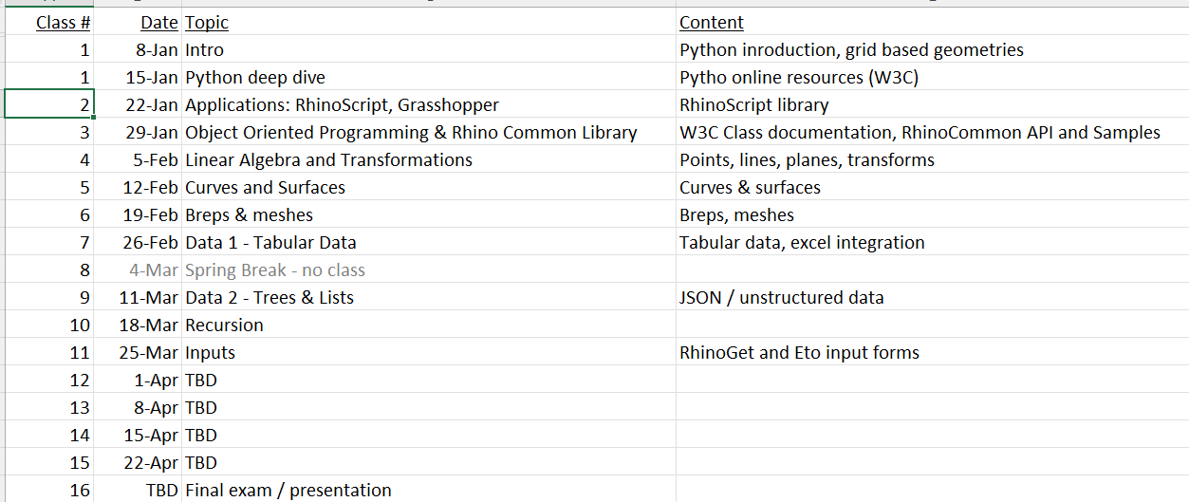
Schedule

Slide 3
Today – key concepts
Object oriented programming
The “Rhino Common” object library
Basic geometric objects (points, lines, planes)
Rhino class, views, etc.
Next week:
  Linear algebra and transformations

Slide 4
Basic constructs
Procedural Programming
There are data and operations on data.
Data
All data are of a type
A = 5 // a variable
B = 5.0
B = “Hi”
Operations
take 1 or more data as inputs
do something internally
return data as output
add(a, 6) // add two numbers, returns a number
5 + 6

Slide 5
Basic constructs
Procedural Programming
There are data and operations on data.
Data
All data are of a type
int a; // a variable
Operations
take 1 or more data as inputs
do something internally
return data as output
add(a, 6); // add two numbers, returns a number
Versus Object Oriented Programming
Packages variables and functions into the concept of an “object”
Person sally = new Person();
Car sallysCar = new Car(sally);
Sally.drive() -> sallysCar.drive();
------------------------------------------------------------
BuildingElement myElement;
myElement.draw();
myElement.delete();

Slide 6
Basic constructs
Procedural Programming
There are data and operations on data.
Data
All data are of a type
int a; // a variable
Operations
take 1 or more data as inputs
do something internally
return data as output
add(a, 6); // add two numbers, returns a number
Versus Object Oriented Programming
There are object classes and instances
MySpecialInteger a; // a is an instance of the
// MySpecialInteger class
There are object state valuables and methods
a.value; // returns the internal value of a
a.Add(b) // asks a to do something
Data and operations are packaged together.
A dot (.) signals we are asking the object to do something, or “passing it a message”

Slide 7
OOP Example: Animals
Abstract Class: Animal
SubclassOf
Abstract Class: Mammal
SubclassOf
SubclassOf
Class: Dog
Class: Human

Slide 8
Classes
#! python3
class Person:
def __init__(self, name, age):
self.name = name
self.age = age
self.children = []
def __str__(self):
ret = f"Hi! My Name is {self.name} and I'm a {self.age} year old {type(self).__name__}\n"
if (self.children and len(self.children)):
ret += f"And I have {len(self.children)} Children:\n"
for child in self.children:
ret += str(child)
#ret += str("A child!\n")
return ret
def addChild(self, achild):
self.children.append(achild)
'''
class Teacher(Person):
pass
class Student(Person):
pass
'''
patty = Person("Patty", 36)
patty.addChild(Person("Bobby", 10))
patty.addChild(Person("Sally", 14))
patty.addChild(Person("Chucky", 8))
print(str(patty))
John
name: “John”
age: 36
Person
instance
Of

Slide 9
Classes
John
name: “John”
age: 36
Instance1
name: “John”
age: 36
Person
instance
Of
RootClass
instance
Of
subclassof
subclassof
Sally
name: “Sally”
age: 25
subject: “Math”
Instance01
name: “Sally”
age: 25
subject: “Math”
Teacher
instance
Of
SubClass01
instance
Of
subclassof
subclassof
Billy
name: “Billy”
age: 15
Instance01
name: “Billy”
age: 15
Student
instance
Of
SubClass02
instance
Of

Slide 10
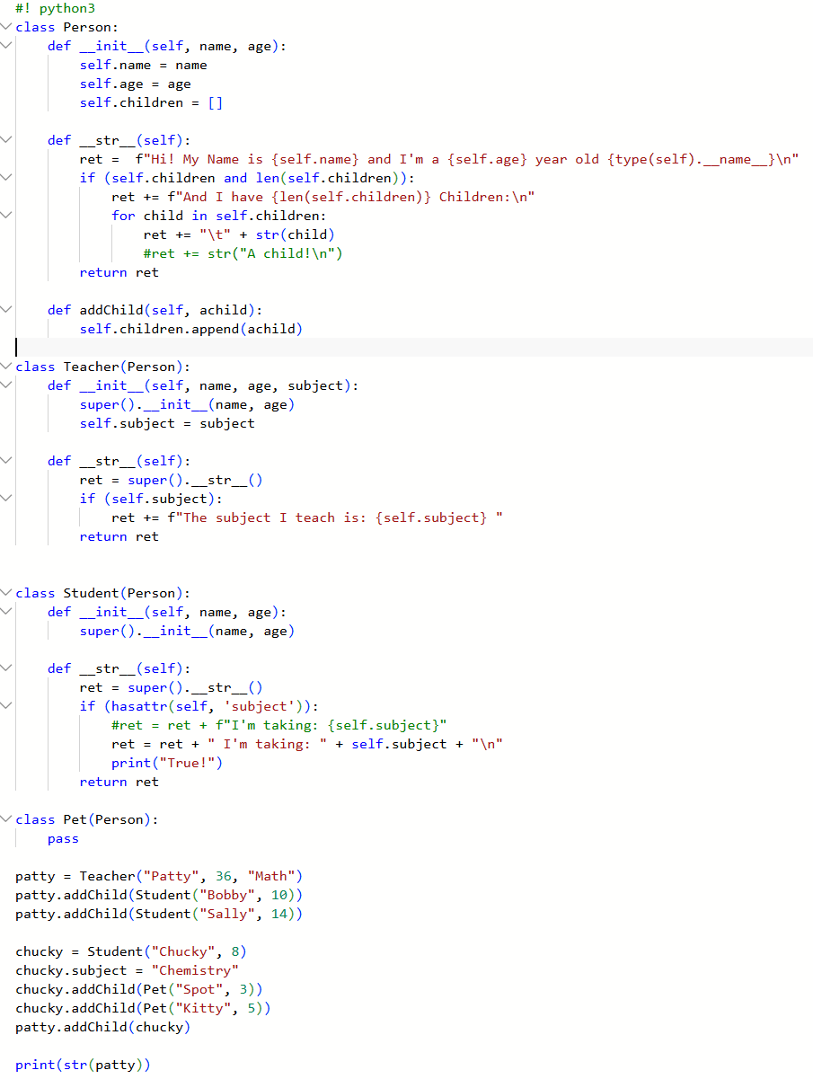
Classes
John
name: “John”
age: 36
children: [Billy, Mary]
Person
instance
Of
Billy
name: “Billy”
age: 15
instance
Of
child
of
subclassof
Mary
name: “Mary”
age: 15
Student
instance
Of

Slide 11
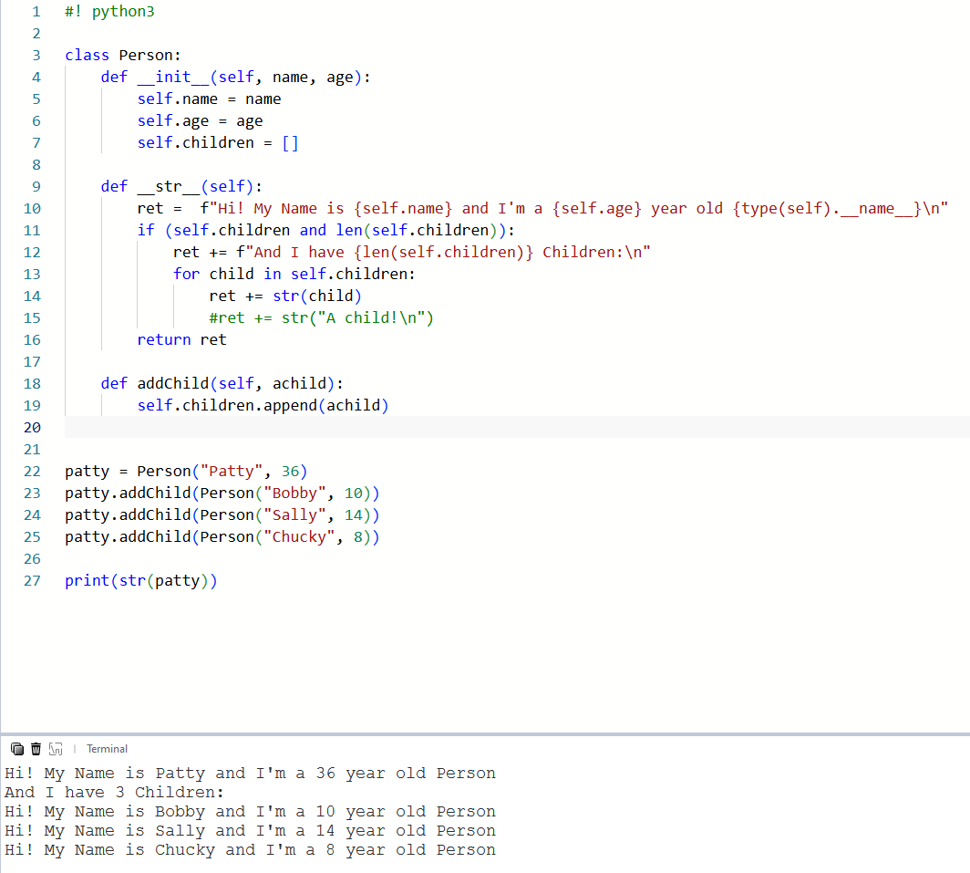
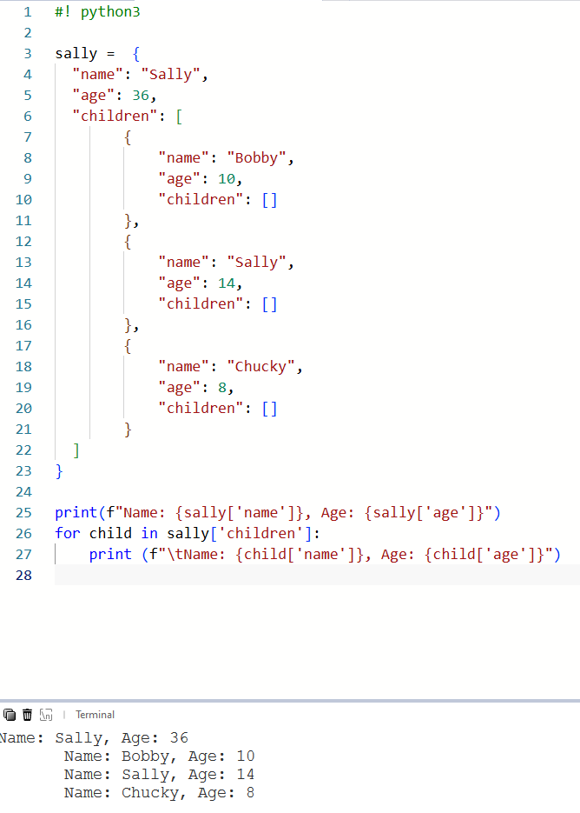
Classes vs. Dictionaries

Slide 12
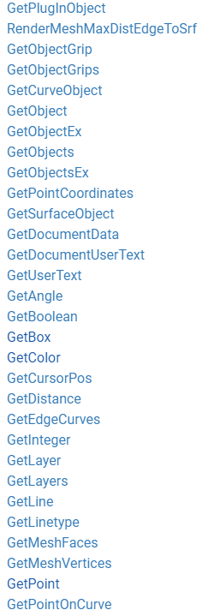
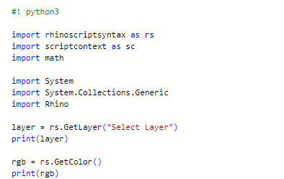
rhinoscript functions

Slide 13
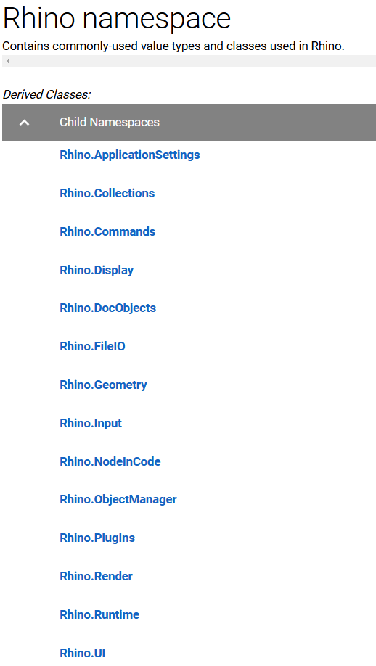
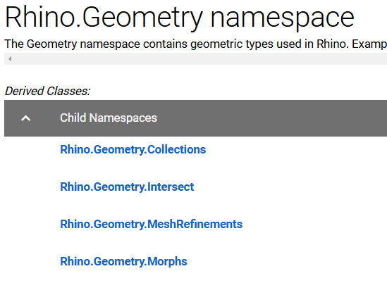
Interesting namespaces

Slide 14
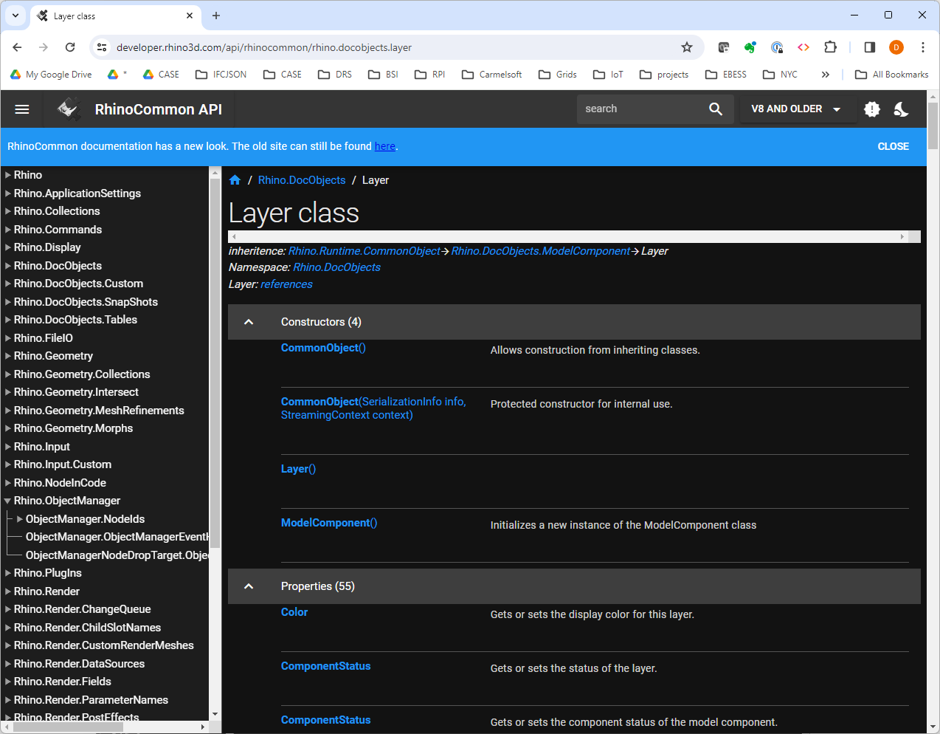
Rhino common object library
https://developer.rhino3d.com/api/rhinocommon/?version=8.x

Slide 15
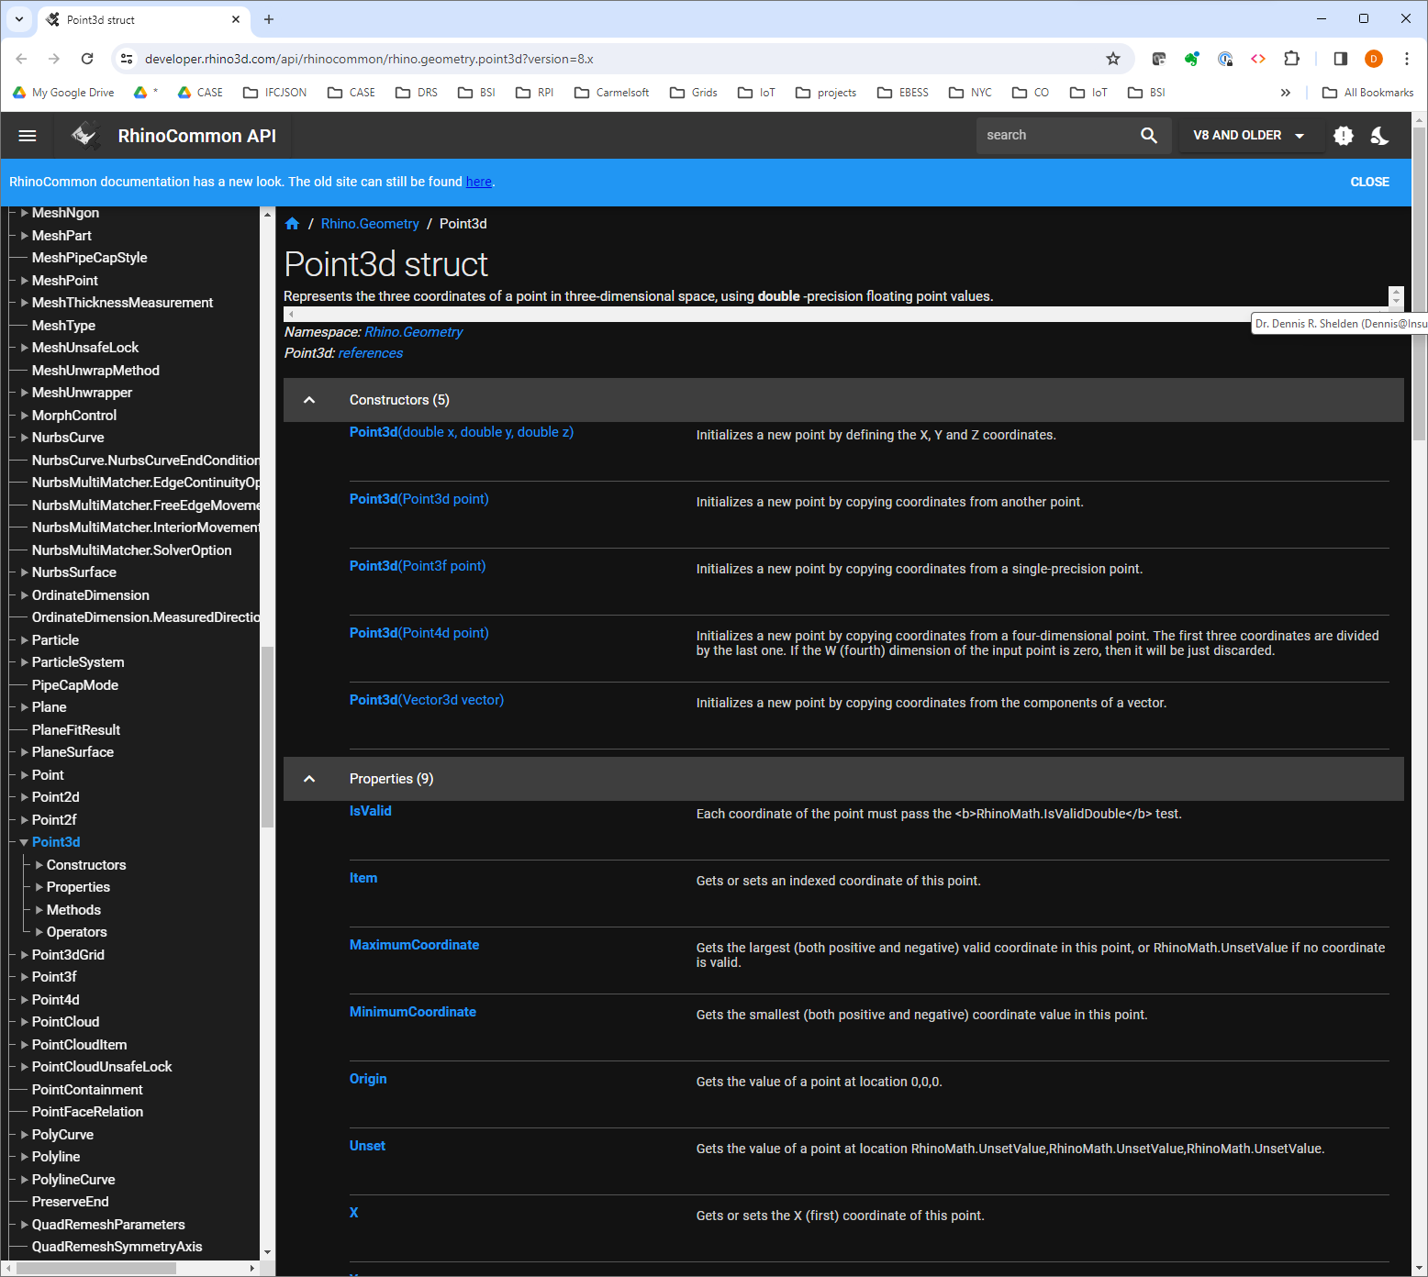
Rhino common: basic geometries

Slide 16
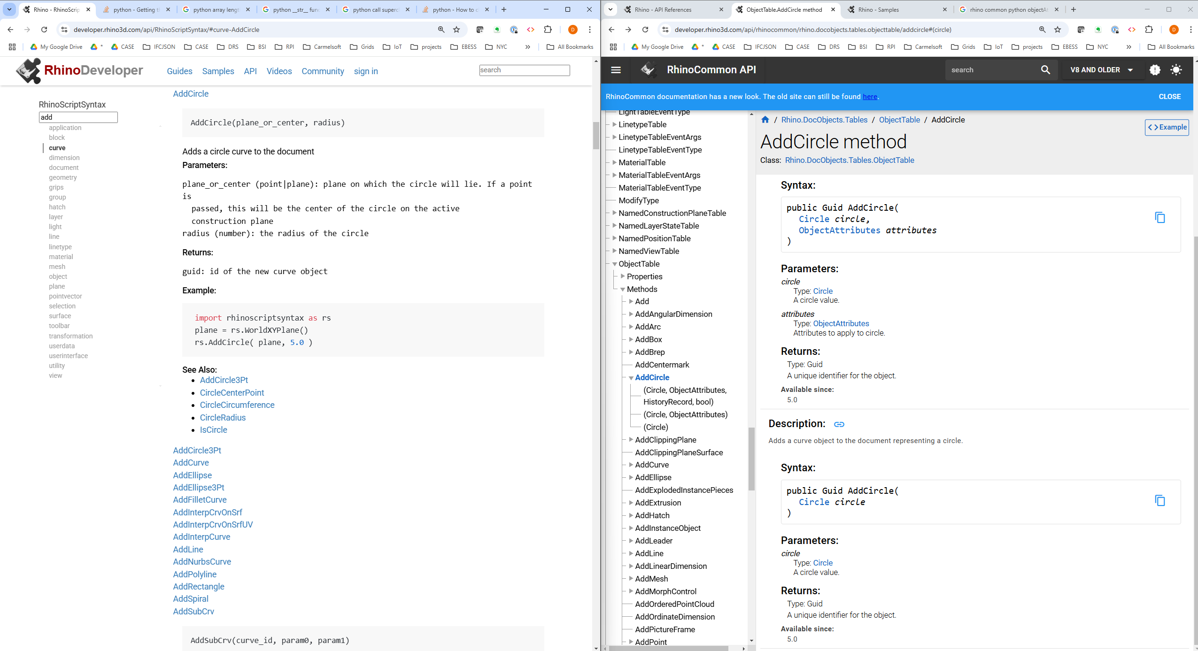
AddObject – 2 ways

Slide 17
AddObject – 2 ways
AddCircle.01.RS vs Common.py
#! python3
import Rhino
import rhinoscriptsyntax as rs
import scriptcontext
from System import Guid
center = Rhino.Geometry.Point3d(0, 0, 0)
radius = 10.0
def AddCircle_common():
c = Rhino.Geometry.Circle(center, radius)
if scriptcontext.doc.Objects.AddCircle(c)!= Guid.Empty:
scriptcontext.doc.Views.Redraw()
return Rhino.Commands.Result.Success
return Rhino.Commands.Result.Failure
def AddCircle_rs():
circleID = rs.AddCircle(center, radius)
if (circleID != Guid.Empty): return Rhino.Commands.Result.Success
else: return Rhino.Commands.Result.Failure
if __name__=="__main__":
AddCircle_common()
# AddCircle_rs()

Slide 18
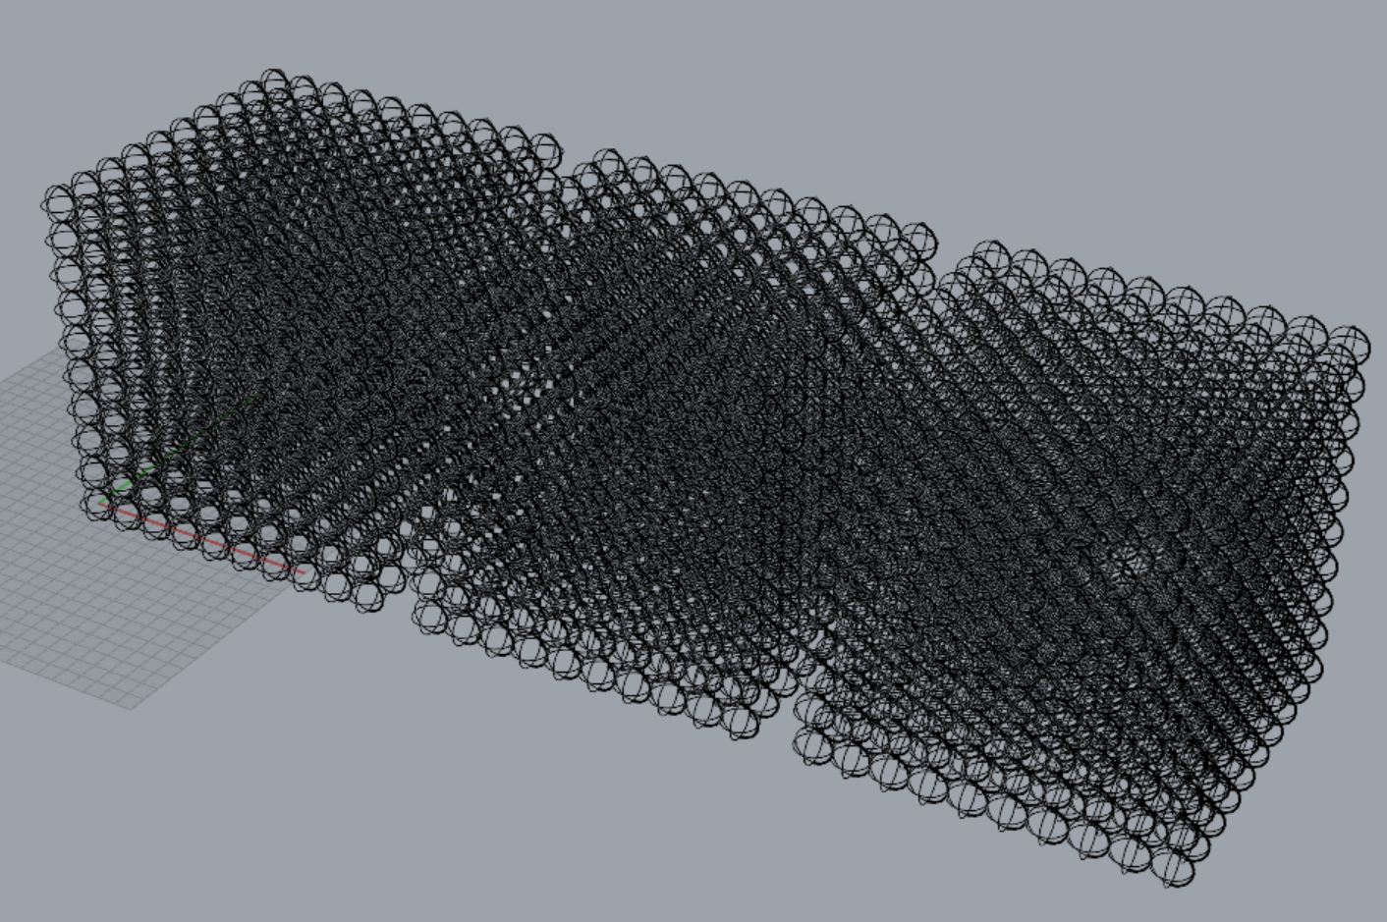
AddObject – 2 ways – speed test
Time Comparison.RS vs Common.py
if __name__=="__main__":
xOffset = 0
time0 = time.time()
MakeSpheres(True, False)
time1 = time.time()
elapsedTime0 = time1 - time0
xOffset += (xCount + 1) * xScale
MakeSpheres(True, True)
time2 = time.time()
elapsedTime1 = time2 - time1
xOffset += (xCount + 1) * xScale
MakeSpheres(False)
time3 = time.time()
elapsedTime2 = time3 - time2
print(f"Times: common without redraw: {elapsedTime0}, common with redraw:
{elapsedTime1}, rhinoscript: {elapsedTime2}")
#! python3
"""Testing pip install specific packages"""
# r: numpy
import rhinoscriptsyntax as rs
import scriptcontext as sc
import System
import System.Collections.Generic
import Rhino
import random
import math
import numpy as np
import time
xCount = yCount = zCount = 10
xScale = yScale = zScale = 10
rSphere = 5
def MakeSpheres(isCommon, redraw = False):
for x in range(xCount):
for y in range(yCount):
for z in range(zCount):
if (isCommon):
sc.doc.Objects.AddSphere(Rhino.Geometry.Sphere \
(Rhino.Geometry.Point3d(x * xScale + xOffset, y * yScale,z * zScale), rSphere))
if (redraw):
sc.doc.Views.Redraw()
else:
rs.AddSphere((x * xScale + xOffset, y * yScale,z * zScale), rSphere)

Slide 19
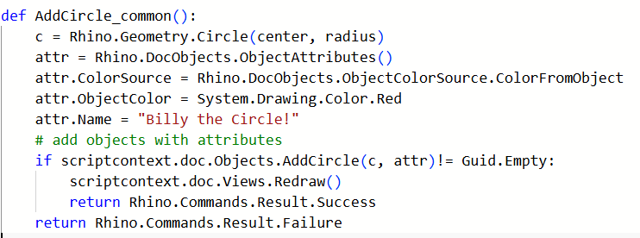
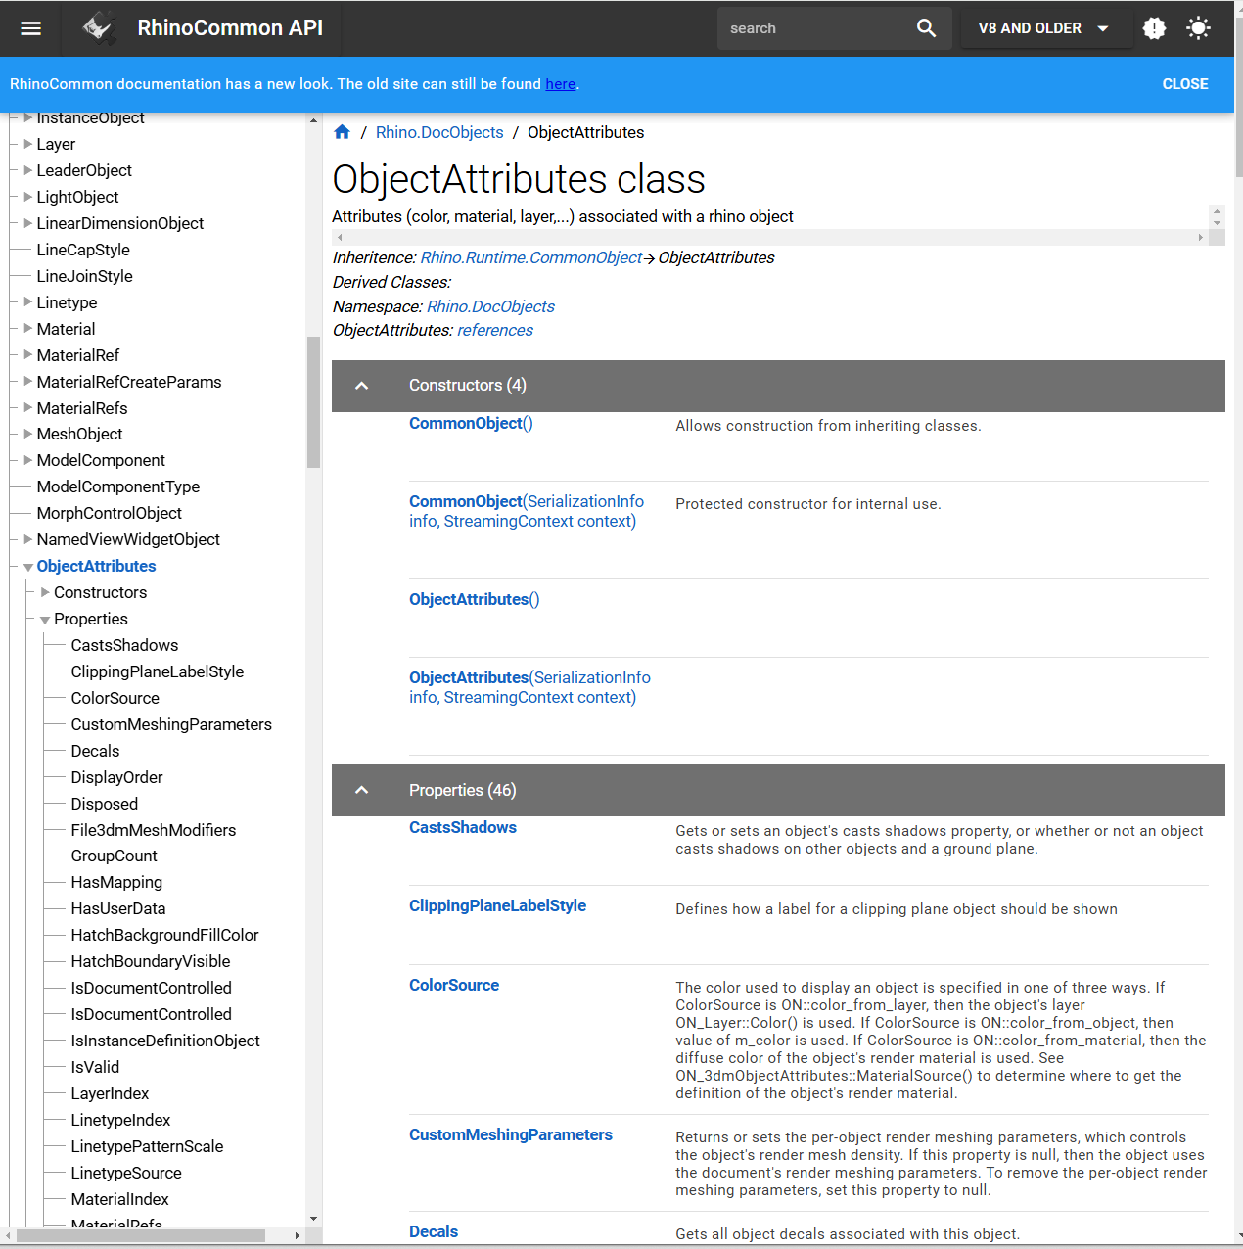
AddObject with attributes
https://developer.rhino3d.com/api/rhinocommon/rhino.docobjects.objectattributes

Slide 20
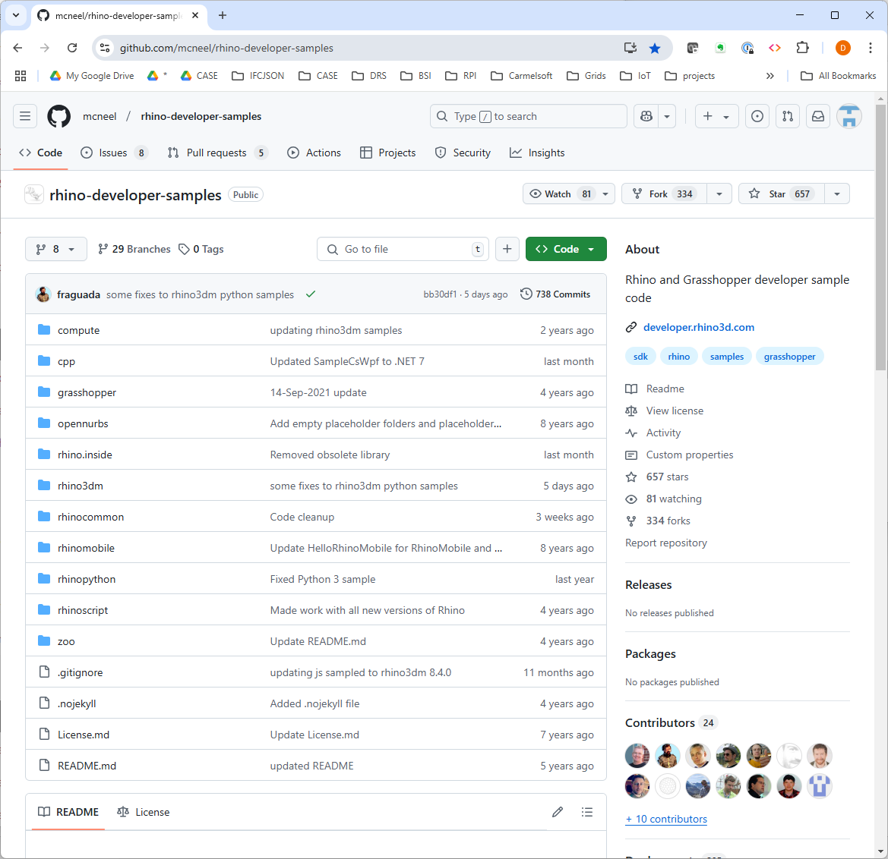
SampleAddRadialDimension.py
SampleAddRenderMaterials.py
SampleAppearanceColors.py
SampleArrayCrv.py
SampleBlockLeader.py
SampleBoxSpaceMorph.py
SampleCircleRadius.py
SampleCreateFromLoftRebuild.py
SampleCurvature.py
SampleCurveDirConduit.py
SampleCurveDivideByCount.py
SampleDescribeObject.py
SampleDeselectObjects.py
SampleDraftAngleCurves.py
SampleDrawBrepEdges.py
SampleDrawExtrudedCurves.py
SampleDrawMeshConduit.py
SampleDumpInstanceDefinition.py
SampleDupSeam.py
SampleEditPoints.py
SampleEtoCollapsibleDialog.py
SampleEtoColorDropDown.py
SampleEtoDialog.py
SampleEtoListBoxDialog.py
SampleEtoModelessForm.py
SampleEtoPushPickButtonDialog.py
SampleEtoRebuildCurve.py
SampleEtoTabbedDialog.py
SampleEtoViewCaptureDialog.py
SampleEtoViewports.py
SampleEventHandler.py
SampleExportCurvesAsJSON.py
SampleExportStep.py
SampleExportUTF8.py
SampleFibonacciSphere.py
SampleGardenPath.py
SampleGetArc.py
SampleGetLiteralString.py
SampleGetPolyline.py
SampleGetSpecificObjectGrip.py
SampleGridViewDialog.py
SampleImportNamedViews.py
SampleMake2dSnapshots.py
SampleMirrorWithHistory.py
SampleModifyInstanceDef.py
SampleMouseCallback.py
SampleMove.py
SampleMoveBrepEdge.py
SampleMultiplePointsConduit.py
SampleNonRationalNurbsSurface.py
SampleNurbsCurves.py
SampleObjectDescription.py
SampleParseTextFields.py
SamplePlaneSurfaceHoleMaker.py
SamplePointCloudColors.py
SamplePointsOnSphere.py
SampleQuadRemesh.py
SampleRationalNurbsSurface.py
SampleRebuildSrfDeviation.py
SampleRibbonOffsetCurve.py
SampleSerialization.py
SampleSetCameraTarget.py
SampleSetCPlaneToView.py
SampleSetCurveWeight.py
SampleSetDetailsToWireframe.py
SampleShowToolbarGroup.py
SampleSphere.py
SampleSphereStyles.py
SampleSynchronizeRenderColors.py
SampleTextBox.py
SampleTextDot.py
SampleTextDotConduit.py
SampleTraverseBrepFace.py
SampleUnroller.py
SampleViewCaptureToFile.py
https://github.com/mcneel/rhino-developer-samples

Slide 21
Assignment
Review W3C Python OOP section
Redo last week’s assignment using rhino common libraries, document differences, compare speed. (defer redraw until the end, remove all intermediate printing)
Look at the github examples.
Pursue 1 interesting “advanced capability” that
maybe can’t be done with rhinoscript but can be done with rhino.common.
  significant layer, view, controller, etc. customization.

Slide 22
